Slide 1
AF182-029 Scientific Data Server “FIREfly”

Slide 2
Today’s presentation
FIREfly project overview
Demo
Discussion and next steps

Slide 3
Part 1. FIREfly Project Overview
Requirements
Proposed solution
Architecture
Prototype goals and tasks
Detours and challenges

Slide 4
AF182-029 Objectives – Develop an…
Open-source web-based data server
That provides a simple and robust capability to
Ingest scientific datasets from various data formats,
Perform SQL-like data queries to find datasets of interest,
View datasets of interest using a web user interface,
Return requested subsets of the datasets of interest to the client in the desired data format for client-side analysis,
Upload Python algorithms to the server to allow for server-side analysis of the datasets of interest,
And be hostable in a Cloud environment.
Notes:
Upload python…: demo in JupyterLab shows this functionality.
It’s worthwhile doing a little bit about JypyterLab and how it works. Aleksandar could do it as intro to JupyterLab section.
Point out that this is actually code running in the cloud, as opposed to the desktop.

Slide 5
Phases
PHASE I: should provide a proof-of-concept.
PHASE II: should provide a working prototype.
PHASE III DUAL USE APPLICATIONS:
Military: Production software for DoD test ranges.
Commercial: Any organization engaged in the collection and dissemination of scientific data.

Slide 6
Proposed proof of concept: Data server with four core functions
INGEST - ingest scientific datasets, especially in Ch10 and HDF5 formats
FILTER - perform SQL-like data queries to find datasets of interest
REDUCE - view datasets of interest using a Web-based user interface, and upload Python algorithms for server-side data analysis
EXTRACT - return subsets of datasets to the client in formats convenient for client-side analysis
Notes:
Proposed solution: Data server with four core functions

Slide 7
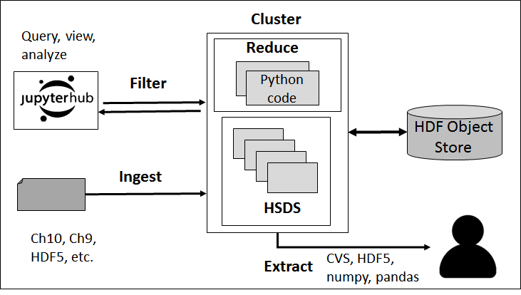

Slide 8

Architecture
Goals:
Enable scalability for compute and storage
Cost effective in terms of hardware and maintenance
Deployable to both cloud environments and on prem
Compatibility with HSDS (HDF Server)
Solution: Microservices architecture based on Kubernetes and Object Storage
Microservices – modular application based on containers
Kubernetes – supports deployment of containers across multiple machines
Object Storage – cost effective and required for HSDS
Notes:
Architecture

Slide 9
Why Microservices and containers?
Containers are deployable units that include software and all its dependencies
Can be deployed on a single server (using Docker) or a cluster (using Kubernetes)
Containerization isolates details about the specific server a container is deployed on from the application
Updates and feature additions are easier to perform compared with monolithic applications
The number of containers can be scaled up to get more work done per unit time (e.g. conversion of ch10 to hdf5)

Slide 10
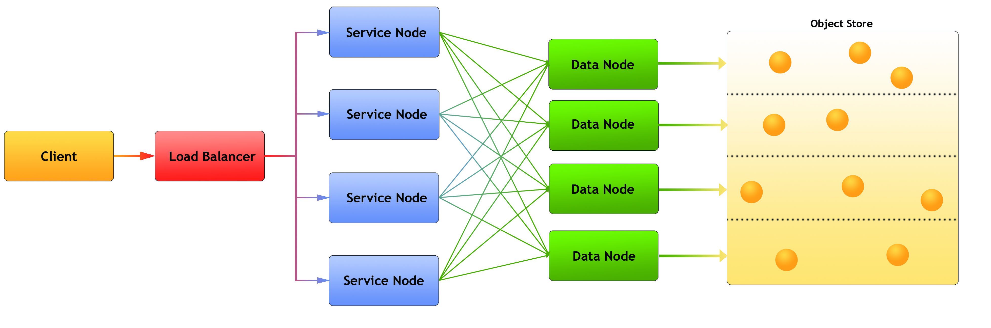
Highly Scalable Data Service (HSDS)
Next generation of HDF Server Project
REST API for reading and writing HDF data
Runs as a set of containers (on Kubernetes or Docker)
Utilizes object storage for data persistence
Parallelizes selection and query requests
Client libraries for Python and C/C++
Notes:
The implementation will be built around the Highly Scalable Data Service (HSDS) [JR2017;CP2018], an open-source cloud-based server that uses object storage to provide scalable, fast storage and access, and can serve any number of simultaneous users or clients.

Slide 11
Highly Scalable Data Service (HSDS)
Next generation of HDF Server Project
REST API for reading and writing HDF data
Runs as a set of containers (on Kubernetes or Docker)
Utilizes object storage for data persistence
Parallelizes selection and query requests
Client libraries for Python and C/C++
Notes:
The implementation will be built around the Highly Scalable Data Service (HSDS) [JR2017;CP2018], an open-source cloud-based server that uses object storage to provide scalable, fast storage and access, and can serve any number of simultaneous users or clients.

Slide 12

Object Storage
Rather than using POSIX compatible storage, Firefly will use object storage (AWS S3 for Phase I) for all persistent storage
Advantages
Cost-effective – 10x cheaper than alternative storage on AWS
Capacity can be added as needed
Built-in redundancy
Throughput scales with the number of nodes
Cloud and on prem solutions available
Notes:
Our proof-of-concept Phase I implementation will use the OpenStack API-compatible Amazon S3 object storage service [S3], because it is far more cost efficient to implement than a pure OpenStack solution, and thus allows us to focus more on other important parts of our system. Fortunately, the design will be easily adapted to any public or private cloud with OpenStack. In Phase II we will use a S3 API compatible object storage system for on prem installation such as Ceph.

Slide 13

JupyterLab and JupyterHub
JupyterLab in conjunction with JupyterHub enables Python codes to be run remotely (i.e. via a web browser)
Advantages:
Reduced Latency and increased throughput (most data transfers stay in the cluster)
No software configuration needed on user’s systems
JupyterLab can be extended to provide custom user interface
JupyterLab is integrated with HSDS
Notes:
JupyterHub and JupyterLab [JupyterLab] will be used as the user interface in the implementation. JupyterHub makes it possible to work interactively with Python and other languages in a web browser. JupyterLab enables Python scripts to be run on the same cluster as HSDS, thus reducing data access latency. JupyterLab is an interactive environment for working with notebooks, code and data. JupyterLab is fast becoming the environment of choice for scientists and analysis, and would seem to be an excellent environment for the target audiences of this project. Another advantage of JupyterLab is that it provides an excellent development platform for adding graphical interfaces, such as the HDFView-type data browser we are implementing.

Slide 14
Containers, managed by Kubernetes
{
Containers
JupyterHub
Ingest Workers
Query Workers
HSDS Nodes
Kubernetes
OpenStack
Notes:
OpenStack – Manages the physical machines used in the data center
Kubernetes – Runs on top of OpenStack – provides container management
JupyterHub/JupyterLab – Each user session accessed through JupyterHub runs in its own container
Ingest/Extract workers – Containers that convert CH10 content to HDF Object storage. Extractors provide regular HDF5/CH10 files for use on desktop
Query Workers – Process queries submitted by users
HSDS Nodes – containers used for HSDS
Adding more physical hw to the Kubernetes cluster enables more containers to run simultaneously without needed to change anything else in the architecture. Having more containers enables more logged on users, more ingest, more query processing, HSDS throughput, etc. The advantage of using Kubernetes vs run directly on specific machines is that the system developer just needs to configure the connections between containers. Kubernetes will deal with which HW the container will be run on.

Slide 15


Reduce
Analyst
User containers
Python code
HDF5 Object Store
Filter
Spawn
Query Scheduler
Query Jobs
Spawn
HSDS
Ingest
Ch10 Ingest/Convert
Watchdog container
Spawn
Ch10 Archive
copy
Extract Scheduler
stream
Ch10 files
Ch10/HDF5/CSV Extract
Requestor
Extract

Slide 16
Prototype tasks
Define data life-cycle.
Implement Ch 10 parsing, summarizing and TMATS extraction.
Implement data conversion, metadata creation, and HDF5 persisting.
Develop a data model that provides a global namespace for a representative subset of Chapter 10 data.
Implement a data repository navigator and data previewer.
Implement a query component, with Python API.
Define and implement representative analysis tasks in Python.
Implement an extraction/download component.
Produce demonstration and final reports.

Slide 17
Decisions made during the project
Synthetic Chapter 10 data generation
Choice of Chapter 10 message types to handle in proof of concept
FIREfly HDF5 format

Slide 18
Synthetic Data Sets
Problem – Lack of real world data sets to demonstrate FIREfly
Require
DoD standard format data e.g. IRIG 106
Large number of data sets
Data for Engineering Unit conversion and storage
Interesting search scenarios
Solution – Generate synthetic data files
Provide
Realistic formats
Realistic data

Slide 19
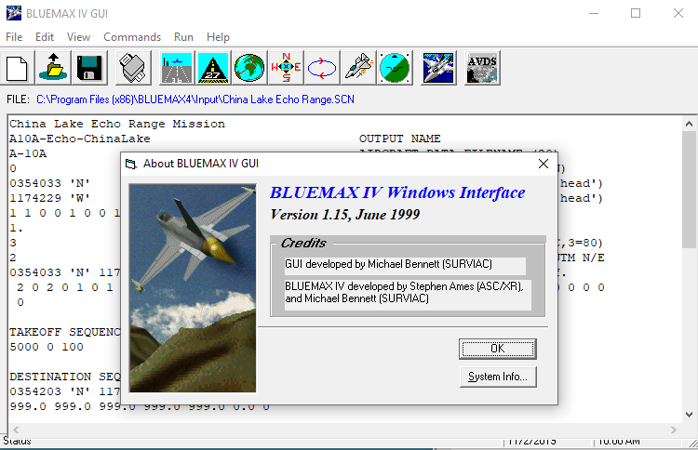
Synthetic Data Sets - Approach
BLUEMAX software to generate realistic aircraft navigation data
Custom software to create IRIG 106 data files with 1553 nav messages

Slide 20
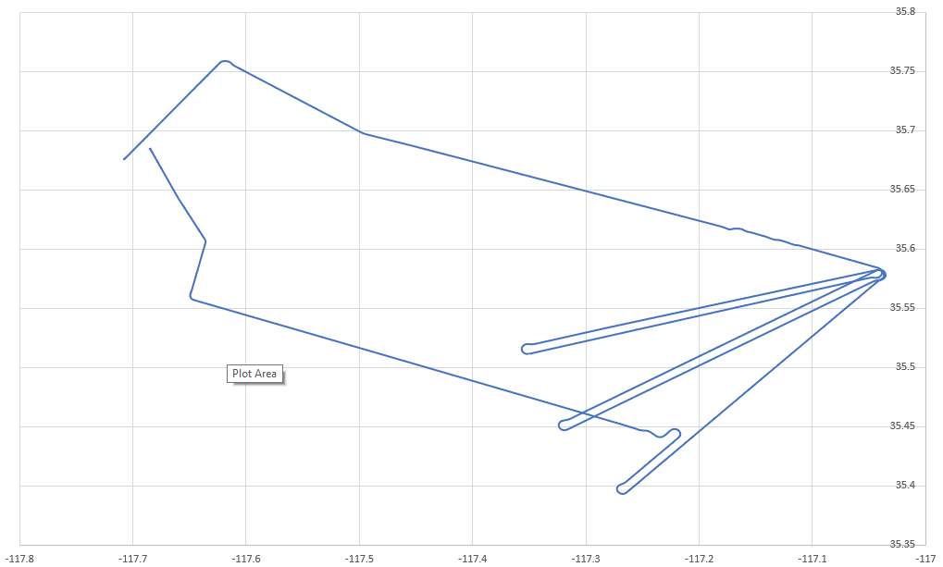
Synthetic Data Sets – 3 Scenarios
3 Basic Scenarios
Takeoff / Land Edwards, fly Echo Range
Takeoff / Land China Lake, fly Echo Range
Takeoff / Land Eglin, fly Eglin Range
2000+ IRIG 106 Data Files
Different Date/Time
Different Aircraft Types
Different Aircraft Tail Numbers

Slide 21
Synthetic Data Sets – Implementation
Generate valid IRIG 106 Ch 10 data file
Valid TMATS
F-16 / C-130 EGI nav 1553 messages from BLUEMAX data
RT to BC
RT to RT
Per simulation data settings
Simulation Date/Time
Aircraft Tail Number
Aircraft Type
Phase 2 would add PCM and Video

Slide 22
FIREfly HDF5 Format

Slide 23
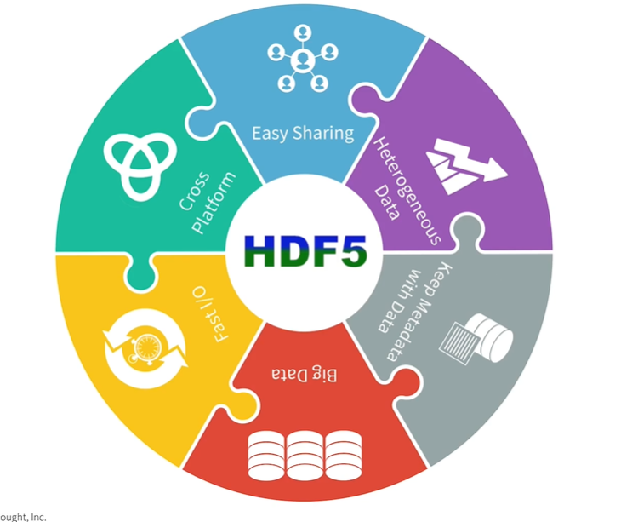

Slide 24
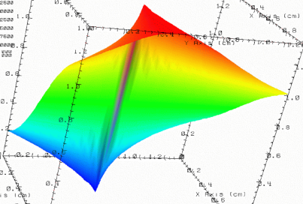


HDF5 container
lat | lon | temp
----|-----|-----
12 | 23 | 3.1
15 | 24 | 4.2
17 | 21 | 3.6
An HDF5 file is a container that holds data objects.
Experiment Notes:
Serial Number: 99378920
Date: 3/13/09
Configuration: Standard 3

Slide 25



“Smart” container
Experiment Notes:
Serial Number: 99378920
Date: 3/13/09
Configuration: Standard 3
/
Parameters
10;100;1000
Viz
SimOut
lat | lon | temp
----|-----|-----
12 | 23 | 3.1
15 | 24 | 4.2
17 | 21 | 3.6
Timestep
36,000

Slide 26
HDF5 Data Model
File – Container for objects
Groups – provide structure among objects
Datasets – where the primary data goes
Attributes, for metadata
Everything else is built from these parts.

Slide 27
FIREfly HDF5 File Lifecycle
One FIREfly HDF5 file stores only the data related to one Chapter 10 file.
Each FIREfly file serves as the container for any data read or computed (derived) from its Chapter 10 file.
Derived data are assumed to be of high-quality and of interest for long-term data analysis.

Slide 28
FIREfly File Content
Three main content “areas”.
Chapter 10 packet data are under the /chapter11_data HDF5 group.
Any derived (engineering units, analysis-ready) data are under the /derived HDF5 group.
Descriptive metadata are in root group HDF5 attributes. Statistical summary information of the derived data is included.
Data analysts can store data in these files any way they consider appropriate using the typical HDF5 API.

Slide 29
Chapter 10 Data in FIREfly Files
Under /chapter11_data HDF5 group
Organized per IRIG106 packet types:
1553 packet data under the /chapter11_data/1553 HDF5 group. The HDF5 hierarchy reflects the channel and the transmitting/receiving remote terminals/subaddresses.
MPEG-2 video under the “/chapter11_data/Video Format 0” HDF5 group.
What packet data information is stored in FIREfly files depends on the packet type.
A compound 1D HDF5 dataset (table) for 1553 packets.
An 188-byte opaque 1D HDF5 dataset for Video Format 0 packets.

Slide 30
Derived Data in FIREfly Files
Under the /derived HDF5 group.
Data analysts free to store their data under this group in any HDF5-compatible way.
For this phase of the project, aircraft location and 6-DOF data are computed on Ch10 file ingest and stored as a 1D compound HDF5 dataset.
Each TMATS attribute as one HDF5 attribute under the /derived/TMATS HDF5 group.

Slide 31
Descriptive Metadata in FIREfly Files
As root group HDF5 attributes.
Any type of information that can be useful for finding flight’s data.
Aircraft type, serial number.
Flight start and end time.
Min/max values of derived parameters if applicable.
Computed takeoff and landing airport.
Chapter 10 file name.
Sha-256 checksum.

Slide 32
Part 2: Firefly Demo

Slide 33
Demo
Building the repository
Working with the data
Demo wrapup

Slide 34
Building the repository
Watchdog
conversion
repository
Notes:
Drag ch 10 file into bucket and it gets converted. Demonstrates how ingest is self-managed .

Slide 35
Working with the data
Searching and viewing with GUI
Using the API
Specifying FIREfly Data Repository
Finding files of interest
Accessing flight data
Flight segments
Extracting data

Slide 36
Demo wrapup
Summary
What is open source
Kita and HSDS

Slide 37
Reduce
Analyst
User containers
Python code
HDF5 Object Store
Filter
Spawn
Query Scheduler
Query Jobs
Spawn
HSDS
Ingest
Ch10 Ingest/Convert
Watchdog container
Spawn
Ch10 Archive
copy
Extract Scheduler
stream
Ch10 files
Ch10/HDF5/CSV Extract
Requestor
Extract

Slide 38
Prototype tasks
Task | Status
Define data life-cycle.
Implement Ch 10 parsing, summarizing and TMATS extraction.
Implement data conversion, metadata creation, and HDF5 persisting.
Develop a data model that provides a global namespace for a representative subset of Chapter 10 data.
Implement a data repository navigator and data previewer.
Implement a query component, with Python API.
Define and implement representative analysis tasks in Python.
Implement an extraction/download component.
Demonstration and final reports.

Slide 39
What existing open source components?
HSDS enables data to be shared between widely distributed users
JupyterLab enables interactive computing via applications running on a remote computer
Docker containers enable deploy applications without the overheads of traditional virtual machines
Kubernetes efficiently manages deployment and monitoring of containers across the cluster
Py106 python package for the irig 106 library

Slide 40
Open source packages developed for this project
firefly-py python package for data query, analysis and visualization
Python 106 extensions for video format 0
HSDS query enhancements
FIREfly GUI query capability
Chapter 10 ingest watchdog
Chapter 10-to-HDF5 converter

Slide 41
Kita and HSDS
Kita
Kita is the open source HSDS plus some special hooks for turnkey solutions
Customers can one-click install using AWS Marketplace
Server auto-configures based on type of instance
Support provided by The HDF Group
KitaLab provides a convenient JupyterLab interface to Kita/HSDS
Kita/KitaLab was used for the FIREfly prototype because it provides a convenient environment in which to implement and demonstrate required capabilities.
The next generation FIREfly would replace Kita/KitaLab with a fully open source solution.

Slide 42
Part 3. Discussion
Questions and comments
Government perspective
Next steps

Slide 43
Thank you

Slide 44
Extra slides

Slide 45
What's missing
To that might be done if there is a Phase 2
Notes:
Major effort to get feedback from analyst communities.
Probably overhaul architecture based on lessons learned, new capabilities., feedback
Generalize metadata handling
Enable experts to transfer knowledge to the general framework.
Add new categories of descriptive statistics/
Add metadata categories to the general framework.
Add parameters and EU conversion capabilities.
Query improvements
Investigate alternative ways of storing both raw and converted data.
E.g. separate Ch 10/11 data into one blob per channel.
E.g. add an index with file locations for each channel.
E.g. storing different time-sequenced EU-converted data channels in compound datasets instead of 1D arrays.
Optionally require permission to download data.
Subtopic
Explore parallelization options on ingest and conversion.
Extraction
Implement extrac workers
Implement ability to convert back to Ch 10 for download
Implement extraction in file browser.
Add access control capabilities (Big job)
Support access control at the attribute, group and dataset level.
Support multiple-compartment security (MCS), role-based access control (RBAC), security caveats across and within messages.
Subtopic

Slide 46
1. Get feedback from data and analyst communities

Slide 47
2. Overhaul architecture based on lessons learned, new capabilities, feedback

Slide 48
Expand Chapter 10 data types covered
Prototype only converts TMATS and 1553 packets.
Expand to handle PCM and other types of data.
Video

Slide 49
Generalize metadata handling
Prototype handles pre-selected attributes.
Next version needs to allow dynamic selection of attributes to be converted, computed, and available for query.

Slide 50
Enable experts to transfer knowledge to the general framework.
Add new categories of descriptive statistics.
Add metadata categories to the general framework.
Add parameters and EU conversion capabilities.

Slide 51
Make query improvements
Revisit and revise query architecture.
Expand repository queries to query data, not just attributes.
Implement query scheduler, optimizer.

Slide 52
Make analysis improvements
Add file visualization capabilities to GUI
Expand API per analyst feedback
Facilitate computing capabilities

Slide 53
Investigate alternative ways of storing both raw and converted data
Separate Ch 10/11 data in HDF5 into one blob per channel.
Add an index with file locations for each channel.
Store different time-sequenced EU-converted data channels in compound HDF5 datasets instead of 1D arrays.
Optionally require permission to download data.

Slide 54
Explore parallelization options on ingest and conversion

Slide 55
Expand extraction capabilities
Implement extract workers
Implement ability to convert back to Ch 10 for download
Implement extract (download) option in file browser.

Slide 56
Add access control capabilities
Support access control at the attribute, group and dataset level.
Support multiple-compartment security (MCS), role-based access control (RBAC), security caveats across and within messages.

Slide 57
Jupyter{Lab, Hub, Notebook} Explained
All part of the Project Jupyter. Its mission: “to develop open-source software, open-standards, and services for interactive computing across dozens of programming languages”.
Interactive computing protocol based on JSON, ZeroMQ, and WebSockets communicates with computational kernels.
Kernels are processes for interactive code execution and introspection in a particular programming language.

Slide 58
Jupyter{Lab, Hub, Notebook} Explained
JupyterLab:
web-based interactive development environment for Jupyter notebooks, code, and data
flexible, configurable, modular, extensible
Jupyter Notebook:
open-source web application for creating and sharing documents with live code, equations, visualizations, and explanatory text
JupyterHub:
multi-user JupyterLab environment with pluggable user authentication
centralized deployment infrastructure
supports Docker and Kubernetes

